Slide 1
Climate Visibility
PW Skills

Slide 2
Project Overview
The objective of this project is to develop a machine learning model that can accurately predict the maximum visibility distance in a given location and weather condition.
The model should take into account various weather parameters such as humidity, temperature, wind speed, and atmospheric pressure, as well as geographical features such as elevation, terrain, and land cover.
The model should be trained on a large dataset of historical weather and visibility data, and validated using a separate test dataset.
The ultimate goal is to provide a tool that can help improve safety and efficiency in various applications such as aviation, transportation, and outdoor activities.

Slide 3
Solution Proposed
Tech Stack Used
Python
FastAPI
Machine learning algorithms
Docker
MongoDB
Infrastructure required
AWS S3
Azure
Github Actions
GitHub Link: https://github.com/PWskills-DataScienceTeam/Climate-Visibility
Dataset used
https://github.com/PWskills-DataScienceTeam/Climate-Visibility/blob/main/notebooks/data.csv

Slide 4
Flow of the Project Demo
Introduction
Environment Setup
Dataset Exploration
Data Preprocessing
Feature Engineering
Model Training & Evaluation
End to End Pipeline Run – Connecting the components of source folder (src)
FastAPI Deployment
Docker
Cloud Deployment
MLOps
Version Control Git GithHub
Final Wrap-Up

Slide 5
Libraries for the Project
Library | Description
boto3 | AWS SDK for Python to interact with AWS services (S3, EC2, etc.).
botocore-stubs | Type hints and auto-completion support for botocore, the core of boto3.
dill | Enhanced serialization tool for Python objects, supporting more data types.
dnspython | DNS toolkit for performing DNS queries and operations.
evidently | Library for monitoring machine learning models and detecting data drift.
fastapi | Modern, high-performance web framework for APIs, based on Python type hints.
from-root | Utility to find the root directory of a project dynamically.
httptools | High-performance HTTP parser used by async web servers like uvicorn.
imblearn (imbalanced-learn) | Library for handling imbalanced datasets (e.g., SMOTE for oversampling).
mypy-boto3-s3 | Type hints for boto3 S3 client, improving IDE autocompletion.
pip-chill | Simplifies viewing and freezing installed Python packages.
pymongo | MongoDB driver for Python, enabling interaction with MongoDB databases.
jinja2 | Fast and powerful template engine used in Flask and FastAPI.
python-dotenv | Loads environment variables from a .env file for configuration.
types-s3transfer | Type hints for s3transfer, an Amazon S3 transfer utility in boto3.
uvicorn | ASGI web server for running FastAPI and other async frameworks.
watchfiles | Monitors file changes in real time, useful for auto-reloading services.
websockets | Enables real-time, two-way communication over WebSockets in Python.
wincertstore | Windows-only package for handling SSL/TLS certificates.
xgboost | High-performance machine learning library optimized for gradient boosting.
python-multipart | Parses multipart/form-data requests, often used for file uploads in APIs.
neuro_mf | A neural network-based meta-feature extractor for ML models.
kneed | Given a set of x and y values, kneed will return the knee point of the function. The knee point is the point of maximum curvature.

Slide 6
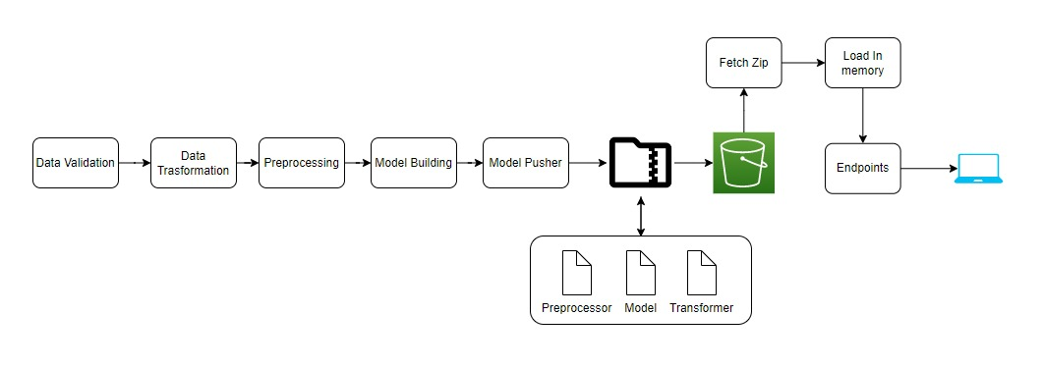
Project Architecture

Slide 7
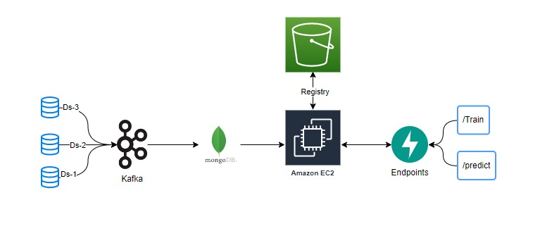
Data Collection Architecture

Slide 8
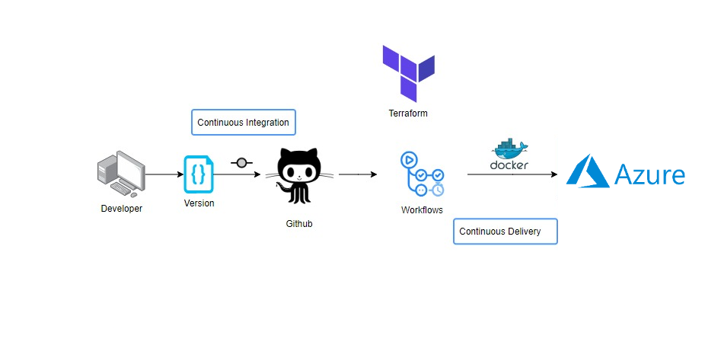
Deployment Architecture

